Slide 1
Cyber Insurance 101
South Texas Chapter Risk & Insurance Management Society
May 17, 2017
Matt C. Green, Marsh

Slide 2
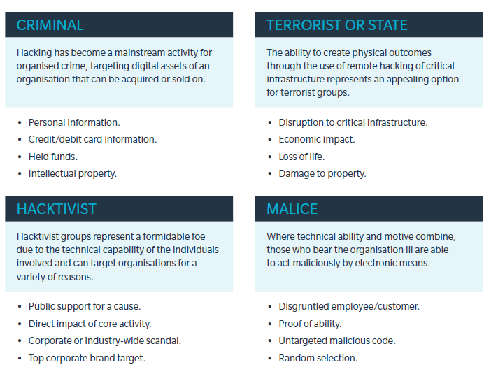
Cyber Insurance
Potential Threat Environment

Slide 3
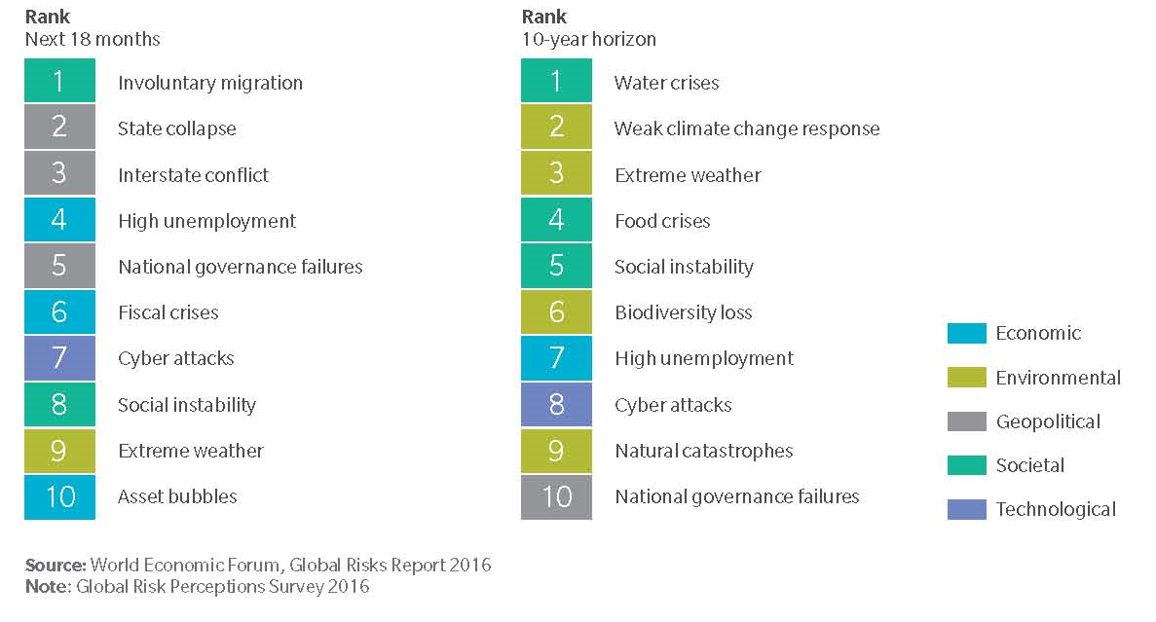
Cyber Insurance
Cyber Attacks: A Growing Global Risk
Costs businesses $400B+ per year.
The world is becoming more dependent on the internet - with the quantity of data in circulation apparently doubling each year and estimates that there will be 50 billion connected devices in the world by 2020 – 6.5 devices for every person on the planet. ^{[1]}
^{[1}

Slide 4
Cyber Insurance
What type of information is at risk?
Consumer Information
Credit Cards, Debit Cards, and other payment information
Social Security Numbers, ITIN’s, and other taxpayer records
Customer Transaction Information, like order history, account numbers, etc.
Protected Healthcare Information (PHI), including medical records, test results, appointment history
Personally Identifiable Information (PII), like Drivers License and Passport details
Financial information, like account balances, loan history, and credit reports
Non-PII, like email addresses, phone lists, and home address that may not be independently sensitive, but may be more sensitive with one or more of the above
Employee Information
Employers have at least some of the above information on all of their employees
Business Partners
Vendors and business partners may provide some of the above information, particularly for Sub-contractors and Independent Contractors
All of the above types of information may also be received from commercial clients as a part of commercial transactions or services
In addition, B2B exposures like projections, forecasts, M&A activity, and trade secrets

Slide 5
Cyber Insurance
What Makes Cyber Risk Unique?
Tech
People
Cyber Risk
Process
Cyber Risk combines:
Technology, which is:
  Complex
  Dynamic
  Obscure
  Dumb
Process, which is:
  Easy to say
  Hard to do
People, who are:
  Smart
  Independent
  Adaptable
  Irrational

Slide 6
Cyber Insurance
Governance key as regulatory scrutiny persists
48 State Breach Notification Laws – Rules for notifying customers/attorney generals when data breached
Massachusetts 201 CMR 17 – Requires proactive information security to keep resident’s data safe
Red Flag Rules imposed by Federal Trade Commission – Requires sign-off by Board of Directors
Payment Card Industry Data Security Standards (PCI DSS) – 12 requirements to protect credit card data
Fair and Accurate Credit Transaction Act (FACTA)
HIPAA HITECH - Health Information Technology for Economic and Clinical Health Act expands HIPAA data security requirements to business associates doing business with healthcare organizations
Children’s Online Privacy Protection Act
Gramm-Leach-Bliley Act
Fair Credit Reporting Act
Computer Fraud and Abuse Act
State attorney general actions and consumer protection laws

Slide 7
Cyber Insurance
Simplified Data Breach Timeline
Actual or alleged theft, loss, or unauthorized collection/disclosure of confidential information that is in the care, custody or control of the Insured, or a 3rd for whom the Insured is legally liable.
Discovery can come about several ways:
  Self discovery: usually the best case
  Customer inquiry or vendor discovery
  Call from regulator or law enforcement
Discovery
Forensic Investigation and Legal Review
      Forensic tells you what happened
      Legal sets out options/obligations
First Response
Public Relations
Notification
Remedial Service Offering
External Issues
Income Loss
Damage to Brand or Reputation
Regulatory Fines, Penalties, and
Consumer Redress
Civil Litigation
Long-Term Consequences

Slide 8
Cyber Insurance
Key Insurance Coverages
 | Coverage | Description | Covered Costs
First Party Cover 1st Party Insurance coverage: direct loss and out of pocket expense incurred by insured | Business Income/ Extra Expense | Interruption or suspension of computer systems due to a network security breach. Coverage may be added to include system failure. | Loss of Income Costs in excess of normal operating expenses required to restore systems Dependent business interruption Forensic expenses
 | Data Asset Protection | Costs to restore, recreate, or recollect your data and other intangible assets that are corrupted or destroyed. | Restoration of corrupted data Vendor costs to recreate lost data
 | Event Management | Costs resulting from a network security or privacy breach: | Forensics Notification Credit Monitoring Call Center Public Relations Sales Discounts
 | Cyber Extortion | Network or data compromised if ransom not paid | Forensics Investigation Negotiations and payments of ransoms demanded
Third Party Cover 3rd Party insurance coverage: defense and liability incurred due to harm caused to others by the insured. | Privacy Liability | Failure to prevent unauthorized access, disclosure or collection, or failure of others to whom you have entrusted such information, for not properly notifying of a privacy breach. | Liability and defense Third party trade secrets Notification to individuals Investigation costs Costs related to public relations efforts Sales Discounts
 | Network Security Liability | Failure of system security to prevent or mitigate a computer attack. Failure of system security includes failure of written policies and procedures addressing technology use. | Liability and defense Bank lawsuits Consumer Lawsuits Sales Discounts
 | Privacy Regulatory Defense Costs | Privacy breach and related fines or penalties assessed by Regulators. | Investigation by a Regulator Liability and Defense costs PCI / PHI fines and penalties Prep costs to testify before regulators Consumer / Bank lawsuits

Slide 9
Cyber Insurance
Carrier Approach – Cyber Policy Breach/Notification Costs
Currently there are two approaches in the market:
  Providing a dollar sublimit
    Pros:
      Insured maintains control of the process
      Insured knows exactly how much money they have available for an “event”
      Can be outside the aggregate limit of liability
    Cons:
      Insurer may not agree to all costs incurred
      Insurer may not approve insured’s selected vendors
      Dollar sublimit may not be sufficient to respond to all costs associated with an “event”
  Providing a per person sublimit
    Pros:
      Typically outside the aggregate limit of liability
      Insured selects response firm from a panel counsel list
      The response is handled by the insurer
    Cons:
      The Insured hands over the response to the insurer’s vendors
      Larger clients, the per person sublimit removes control which they expect to maintain
      Typically only offered to companies with <$5B in revenue

Slide 10
Cyber Insurance
Carrier Approach – Value Added Services
Partnerships With Third Party Vendors
Loss Prevention
  Cybersecurity risk assessment.
  “Dark Web” data mining and monitoring.
  Vendor security ratings.
  Employee education (e.g., phishing).
  Vulnerability scanning.
Claims
  Breach coach.
  Incident response, including forensics.
  Crisis communications.
Information Sharing
Business Continuity Planning/Resiliency

Slide 11
Cyber Insurance
Understanding the Gaps in Coverage
GENERAL
LIABILITY
D&O
TYPES OF
POLICIES
PROPERTY
ERRORS AND
OMISSIONS
FIDELITY
AND CRIME

Slide 12
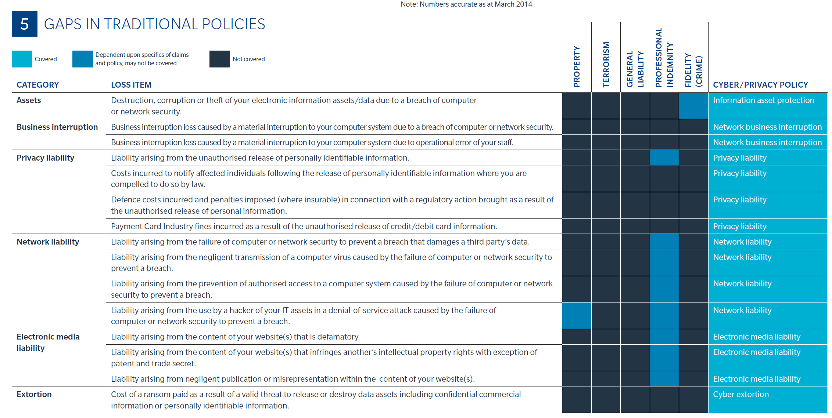
Cyber Insurance
How Does a Cyber Policy Fill Gaps in Traditional P&C Policies

Slide 13
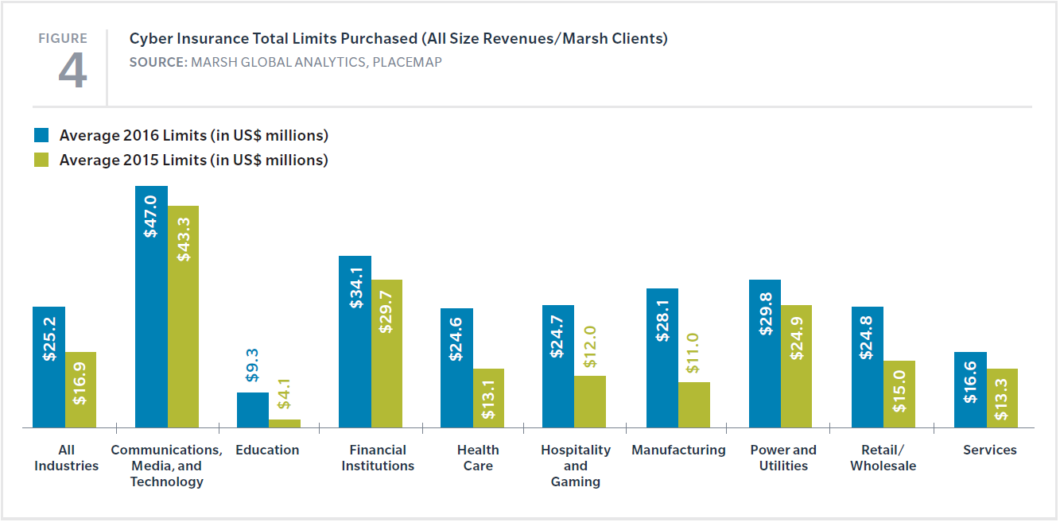
Cyber Insurance
What’s happening in the insurance market today?
Trends & Developments
Standalone Cyber Insurance
Increasing Limits
Larger Losses
Abundant and Increasing Capacity
Business Interruption / Property Damage
Cyber Extortion
Social Engineering

Slide 14
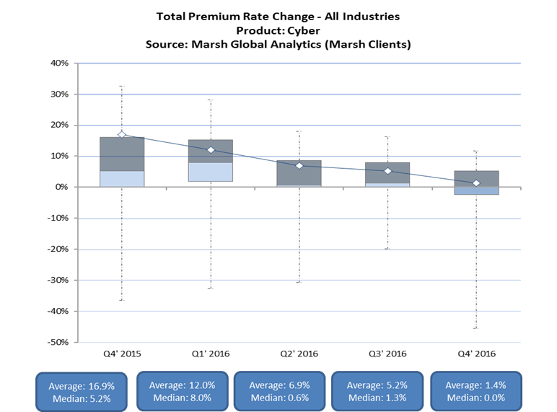
Cyber Insurance
Cyber Market Update
In Q4 2016, cyber rates increased by an average of 1.4% for all industries within Marsh’s client base.
Competition among insurers is strengthening for clients in all revenue segments and all industry sectors, including higher-exposure classes like retail and health care as well as emerging classes like critical infrastructure and manufacturing.
Sub-limits for certain cyber coverages (for example, notification, payment card, and regulatory costs) are trending higher, with many clients exploring “full” limits for these covers.
Clients continue increasing their total program size, due in part to a growing recognition of the risk. Overall, insurer appetite remains strong, with a market-wide focus on growth in 2017 and many carriers developing new coverages and services. New entrants continue to proliferate, both domestically and in the London market.

Slide 15
Cyber Insurance
Current State of Underwriting
Growing Market
  Gross written premiums expected to increase from $2.5B in 2014 to $7.5B in 2020.
  Capacity remains steady at approximately $500M.
  New area of opportunity in otherwise soft Property and Casualty markets.
  Traditional or “legacy” Cyber insurers threatened by naïve capacity.
Opportunity Riddled With Uncertainty
  Where else (which policies) are insurers exposed to Cyber claims?
  Aggregation and concentration continue to be a major concern.

Slide 16
Cyber Insurance
Traditionally Uninsurable Cyber Risks
Property Damage caused or contributed to by a cyber event (with growing exceptions). Property carriers starting to provide some Cyber Business Interruption coverage; many exclude it.
Bodily Injury caused or contributed to by a cyber event (with exceptions).
Misappropriation of Trade Secrets (direct loss).
Patent Infringement Liability.

Slide 17
Cyber Insurance
The Next Evolution of Cyber Risk
Cyber Security
Cyber Risk Management
Cyber Security is a problem to be solved
Cyber Security issues can be prevented
Cyber Security is a technology problem
Cyber Security is a problem for the IT department
Cyber Security is a temporary issue
Cyber Security is all about (data breaches | cyber terrorism | <insert other scenario here>
Cyber Risk is a race without end
Cyber Risk cannot be eliminated
Cyber Risk Management encompasses people, processes, and technology.
Cyber Risk Management engages the entire enterprise
Cyber Risk Management is a permanent entry on the risk register
Cyber Risk is a multitude of issues reflecting the pervasive nature of technology

Slide 18
Outside Vendors
Common practice to require Cyber coverage for outside vendors
  Take overall services into account when requiring Cyber coverage
  Reasonable to request that coverage be maintained for virtually all technology related vendors
  Many times requirement is packaged with Technology E&O insurance requirements
Sample Wording
  “…Costs to be covered by this insurance policy shall include without limitation: (a) costs to notify individuals whose Personal Data was lost or compromised; (b) costs to provide credit monitoring and credit restoration services to individuals whose Personal Data was lost or compromised; (c) costs associated with third party claims arising from the Security Breach or loss of Personal Data, including litigation costs and settlement costs; and (d) any investigation, enforcement or similar miscellaneous costs. Such insurance shall provide coverage for up to $x,000,000.00 (x million dollars). For the purposes of this Section, " Security Breach" means (1) the failure by the Vendor to properly handle, manage, store, destroy or otherwise control, or the unauthorized disclosure by the Vendor of: (a) Personal Data in any format or (b) third party corporate information in any format specifically identified as confidential and protected under a confidentiality agreement or similar contract; (2) an unintentional violation of the Vendor's privacy policy or misappropriation that results in the violation of any applicable data privacy laws or regulations; or (3) any other act, error, or omission by Vendor in its capacity as such which is reasonably likely to result in the unauthorized disclosure of Personal Data…”

Slide 19
Cyber Insurance
5 Best Practices
When In Doubt, ENCRYPT
Know where your data is
Know what you can do with it
Remind your staff of the rules
Address your data collection and deletion policy

